Slide 1
Achieving Success Through International
Partnerships and Collaborations
Prof. David Taylor
Pro Vice-Chancellor (International)

Slide 2
Partnerships and Collaborations University – Industry
The role of the modern University
Support the knowledge economy
Wealth creation and growth in GDP
Supply of creative and entrepreneurial graduates
Working closely with industry

Slide 3
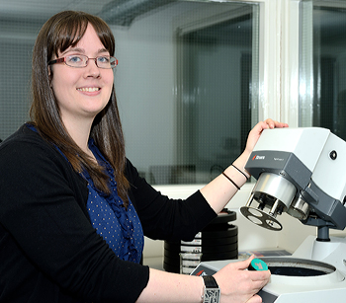
How do we do this?
Student sponsorship
Student work placement and internship programmes
Collaborative research
Industry on campus

Slide 4
3M Buckley Innovation Centre
Industry on campus
Home to almost 70 companies
Student projects
Student start-up
Research collaborations
Spin-out and Spin-in companies

Slide 5
In Libya
Rapid rate of change
Need to rebuild quickly
University - Industry Even more important
Support from government

Slide 6
Partnerships and Collaboration University – Industry

Slide 7
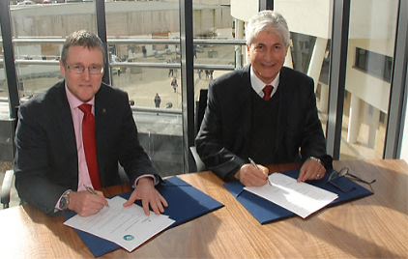
Partnerships and Collaboration University – Industry
UKTI
British Council
Ministries
Governments

Slide 8
Partnerships and Collaboration An Example
Over 100 forensic scientists
Partnership between university and industry
12 graduates will return for PhD
Consultancy on laboratory design

Slide 9
Lessons
University – University – Industry – Industry
Governments / Ministries / Agencies
Happened at the height of the unrest
Travel to Libya for us was almost impossible
Flow of funds to students dried up - many experienced severe difficulties
Students very distressed
Embassy and Home Office were very supportive
A great opportunity to contribute to the future of the emerging Libya
Were eventually able to hold a graduation ceremony in Libya (Tripoli)

Slide 10
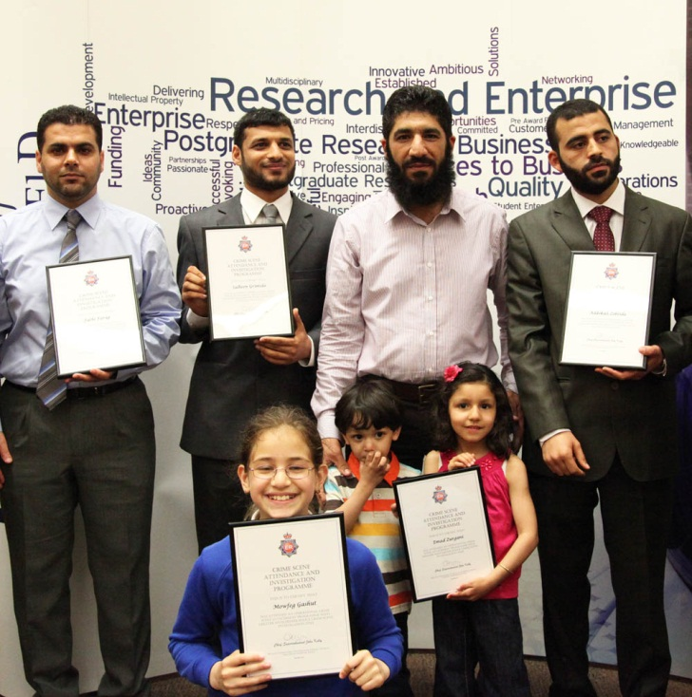
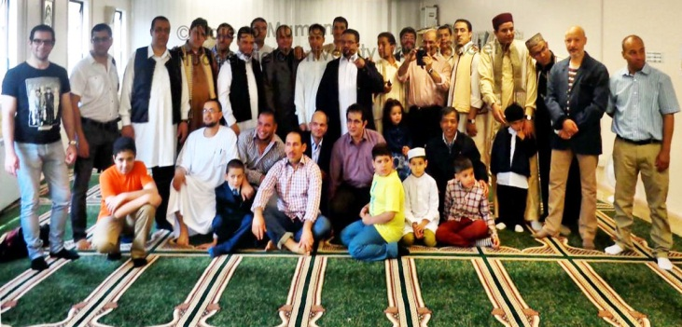
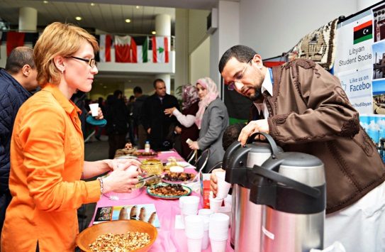
Thanks!

